Slide 1
Study on Suicide Trends in Arizona
Alesa Hipps
Brian Fischer
Chris Bill
Taoufic Gandi

Slide 2
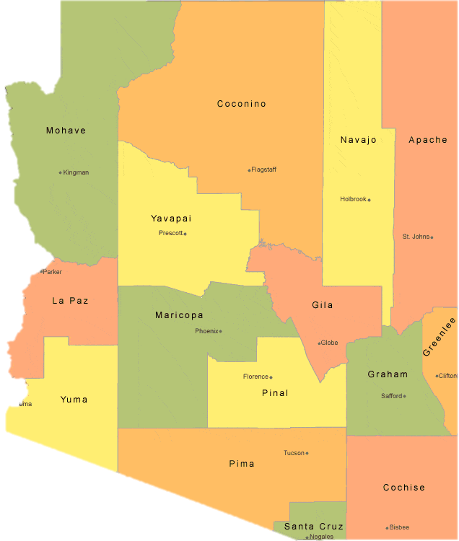
Study Motivation
Nearly four Arizonans a day died by suicide in 2017
The overall suicide rate rose in Arizona from 15.4 suicides per 100,000 population in 2006 to 18 suicides per 100,000 in 2017.
Suicide was the 8th leading cause of death among males (28.1 per 100,000 residents) and 11th among females (8.4 per 100,000 residents).
We decided to analyze the TOP THREE* indicators (% of divorced adults, % of Veterans 25 and over, and % of married adults), along with one “potential” indicator (temperature) to see if correlations hold true across Arizona’s counties
https://www.livestories.com/blog/how-suicide-rates-correlate-with-other-factors

Slide 3
Defining Hypothesis
Hypothesis
Null Hypothesis
Do changes in family and population structure affect the suicide rate.
Do any other factors affect suicide rate in AZ?
Family structure and population changes have no impact on suicide rate. In fact there are no causalities

Slide 4

Data Gathering
Arizona Department of Health
Census
Veteran Population
To get the suicide data for past 10 years
Census
Census
To gather marriage and Divorce rate for past 10 years
AZ population growth for past 10 years
NOAA Queries
To get local climatological temperature data

Slide 5
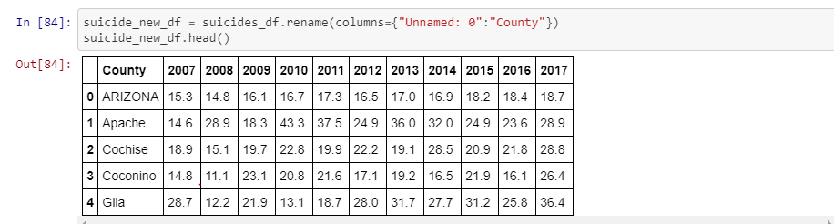
Data Gathering cont’d
Step 1: Identifying sources for Suicide data at the state and county level
Annual reports from the Arizona Department of Health Services going back to 2007: https://pub.azdhs.gov/health-stats/report/ahs/index.php
Variable: ‘Intentional self-harm’
Standardized metric is ‘number of suicide per 100,000 persons’.
Rate increased from 15.8 per 100,000 persons in 2007 to 18.0 in 2017.

Slide 6
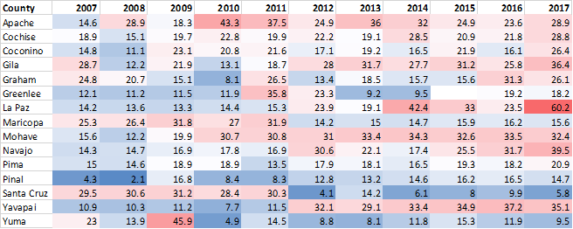
Arizona Suicide Rates by County: 2007-2017
Per 100,000 individuals

Slide 7
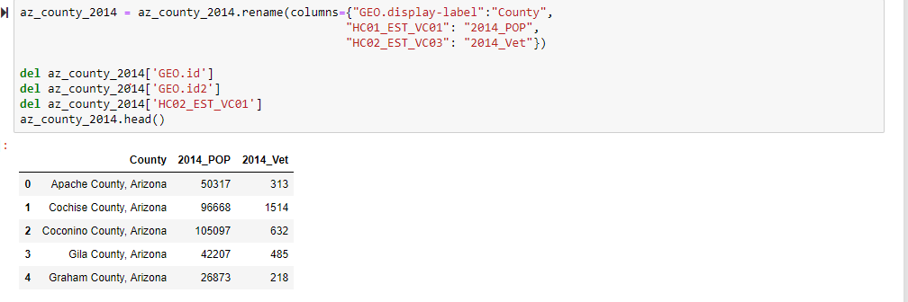
Data Analysis
Step 2: Identify potential suicide risk factors and analyze for possible relationships
Team conducted Initial research
Variables: Veteran Population, marriage/divorce and weather (i.e. temperature)
Veterans data comes to us through the American Community Survey, 5-year datasets.
Post 2001 Veteran Population: 0.9% to 2.0%

Slide 8
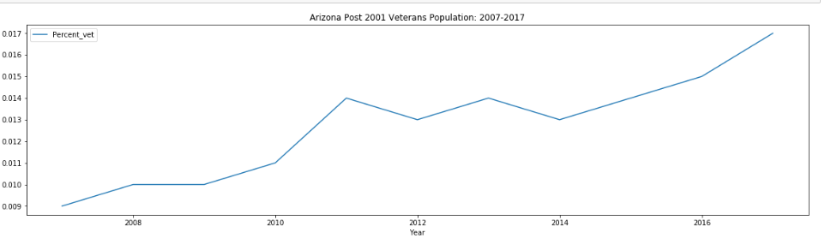
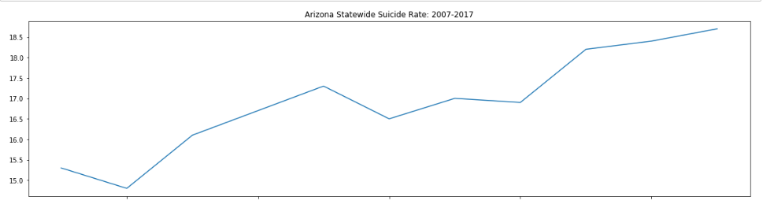
Arizona Statewide Suicide Rate vs % of Population Veteran Status

Slide 9
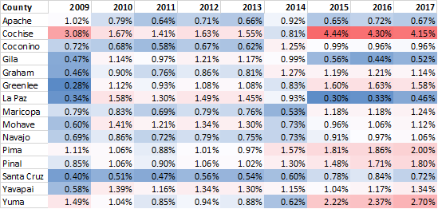
Veteran Population By County
Civilians Age 25 and Above

Slide 10
Temperature Data Collection
Data Analysis Continued..
National Climatic Data Center - National Oceanic and Atmospheric Administration (https://www.ncdc.noaa.gov/cdo-web/datatools/lcd)
Data Tools - Local Climatological Data: Query by State / County / City / Date
Hourly samples for each day; 100 columns or so of readings and statistics
Max query size is roughly 10 years → 50MB csv file
Choose one representative city for each county (i.e. the county seat, or one with sufficient data)

Slide 11
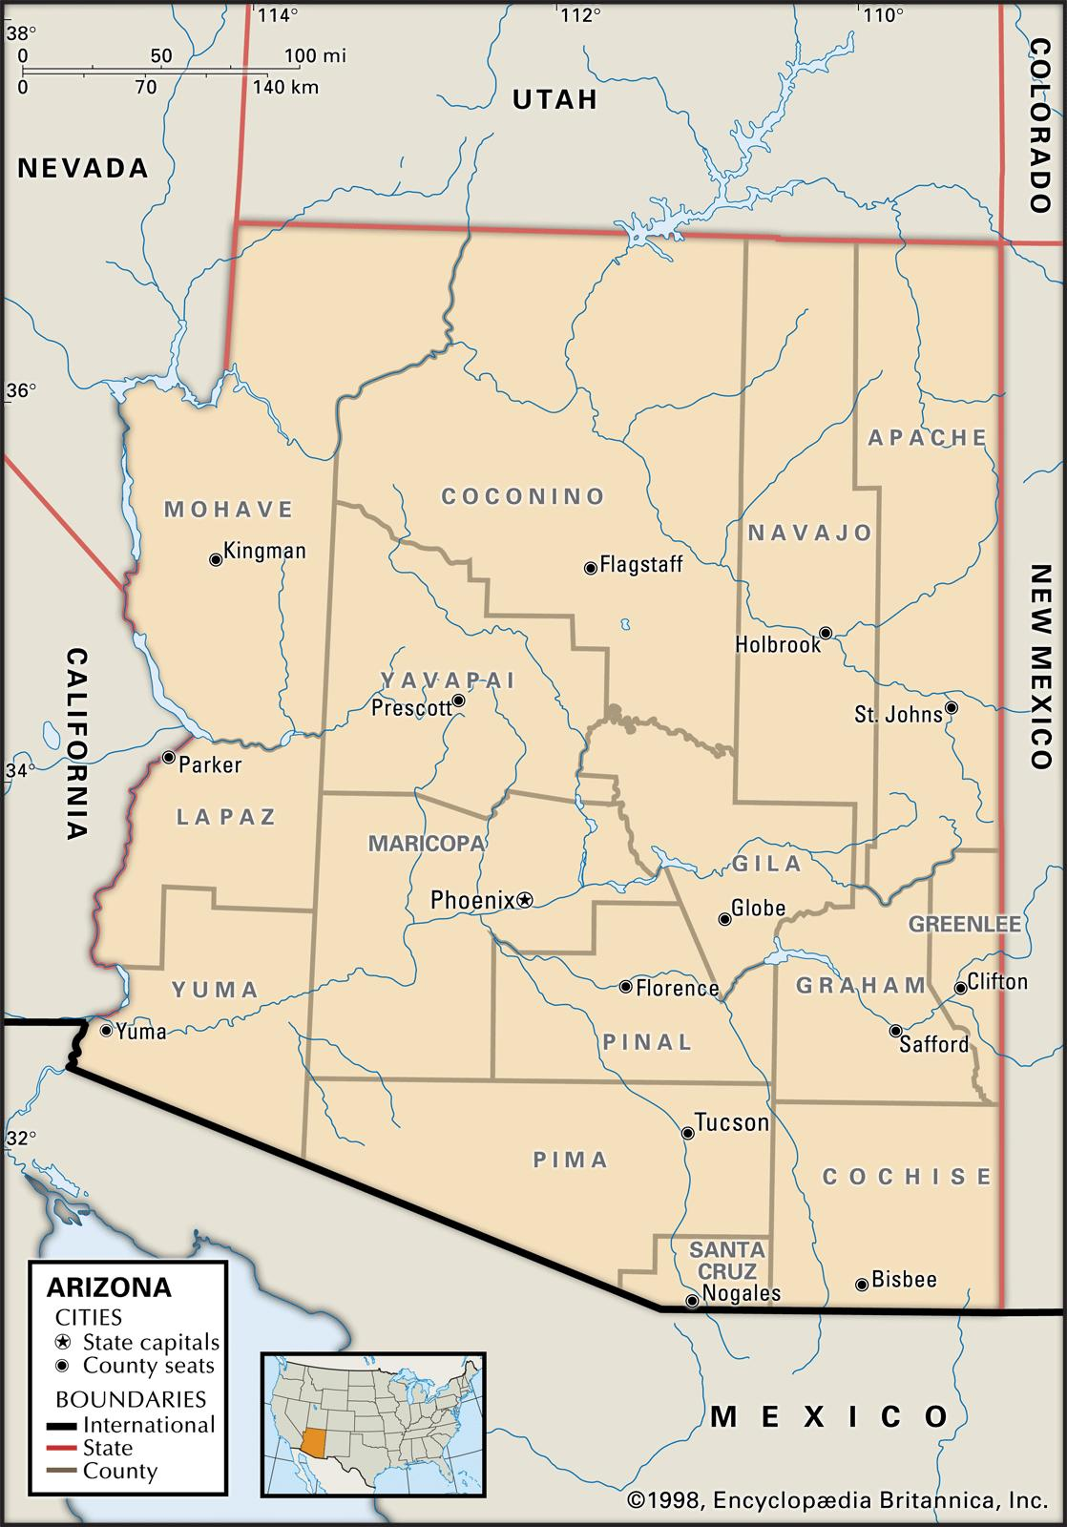
Temperature Data Collection
Temperature Analysis Continued..
Substitutions:
Globe → Payson
Clifton → N/A
Parker → Lake Havasu City
Holbrook → Winslow
Florence → Casa Grande

Slide 12
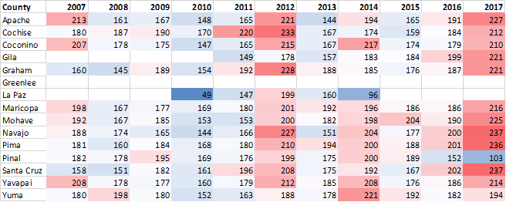
Number of Days Above Average Daily Temperature
Note: Not every dataset contains 365 days

Slide 13
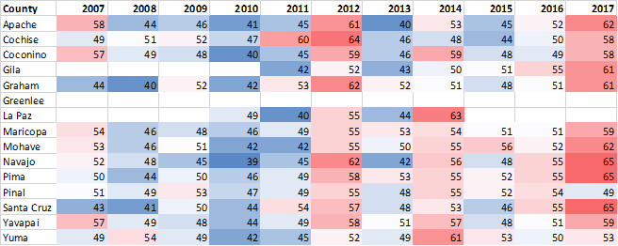
Percentage of Days Above Average Daily Temperature
Normalized to number of days in dataset

Slide 14
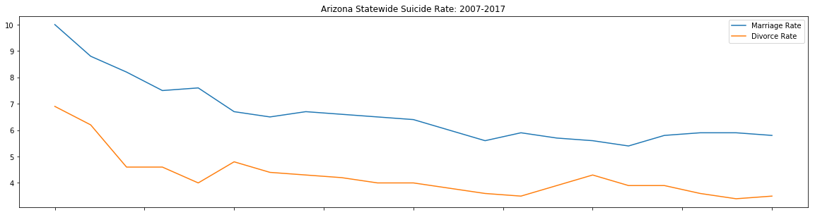
Marriage & Divorce Data
Data Source: : The Data was pulled from the Census Fact Finder page. That data is pretty granular as it breaks down the rate by race and by age group
Data Cleaning: It consisted of essentially dropping in all the Age group and race rows in order to have an overall picture
Observations: Strong correlation between Suicide Rate and Marriage and Divorce Rate

Slide 15
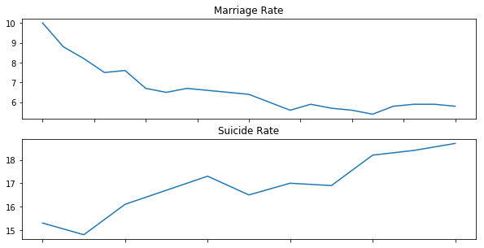
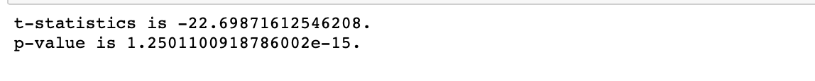
MARRIAGE DATA VISUAL

Slide 16
Discussing Our Findings
Divorced (% of adults)
Veterans (% of civilians 25+)
Expected 0.6
Expected 0.58
Temperature (% days above average)
Married (% of adults)
Didn’t know what to expect!
Expected 0.44

Slide 17
Questions/Comments?

